Slide 1


Road Map of Power Discrete
钟添宾
2015.07
Will be one of the best semiconductor providers worldwide.

Slide 2
Roadmap of Power Discrete
Production
Developing
Planning
JS-MOS
(>500V)
Quick
Charge
BJT
Wide Bandgap
Technology
SiC GaN
Schottky
Barrier Diode
VDMOS
(>500V)
IGBT
Thyristor
…
FRD
JFET
CSP
MOSFET
Zener
TMBS
MOSFET With
ESD Protection
Diode
JBS
First Power
MOSFET
(WNM75N80)
2007
2009
2011
2012
2013
2015
2017
2018
2019

Slide 3
Roadmap of Power MOSFET
Production
Developing
Planning
PDFN3*3
20V/8mΩ
WNM07N60
WNM07N65
WNM12N65
WNM20N60S
WNM20N60SF
DFN2*3FC
20V/12m Ω
DFN2*2FC
20V/16m Ω
representative
products
WNM07N60F
WNM07N65F
WNM12N65F
PDFN3*3
20V/9.3mΩ
CSP2.7*1.81
20V/9.5 mΩ
WPM2019
WPM2031
WNM4002
WNM2030
WCM2002
WCM2007
WNM3017
DFN2*3FC
20V/15m Ω
CSP1.61*1.61
20V/20 mΩ
WNMD2171
WNMD2169
Wpm2048
wpm2049
DFN2*2FC
20V/20m Ω
CSP3.54*1.77
12V/2.3 mΩ
WPM2026
WPM2301
WPM1480
WNMD2172
WNMD2168
WNMD2167
WNMD2166
WNM2310
WNM2023
WNM2024
WNM2025
WNM2306
WNMD2155
WNMD2156
WNMD2157
WNMD2173
WNMD2174
WNMD2176
WNMD2179
CSP2.7*1.81
12V/10 mΩ
CSP2.7*1.81
12V/4.5 mΩ
WPM4801
WPM3401
WPM4803
WPM3407
WPM9435
WNM6001
WNMD2165
WNMD2162
WPM2005
WPM2005B
WPM2006
WPM2341
CSP1.81*1.81
20V/20 mΩ
CSP1.91*1.46
12V/7.5mΩ
WNMD3008
WPM1485
WPM2065
WNM75N80
TO-220
WNMD2158
WNMD2160
WPM1481
WPM1488
WCM2068
WCM2070
WNMD2178
WNMD2180
CSP1.01*1.01
12V/24 mΩ
CSP MOS
2007
2010
2014
2015
2016
First Power
MOSFET
75V/80A
Pitch=2.8um
MOSFET With
ESD Protection
Diode
Key
Tech
P Channel
Pitch=3.2um
Small Pitch
(1.3um)
HBM ESD>2KV
Top Drain
12V-Pch
High Voltage
VDMOS(>500V)
CSP
Shield Gate
Shield Gate
Self Align

Slide 4
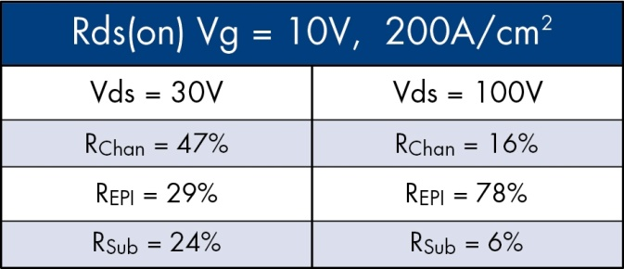

Trench Low Voltage MOSFET Technology
Trend - N Channel 25V to 150V
PT1
40M
PT2
100M
PT3TBO
100M
First power trench
technology
PT4
100M
Reduced pitch
Lower Rdson & Qg
PT5
133M
PT5 RP
200M
PT6
1B
Thick Bottom Oxide
Lower Qgd
PT8
1B
Thin Substrates
Lower Rdson
PT10
~2.5B
Continuous FOM improvement.
Increasing Power Density
Small form factor
Improving Performance
Charge balance
Shield
Lower Rdson/Qgd
Pitch reduction
Charge balance
Shield
Lower Qgd
Pitch reduction
Charge balance
Self Aligned
Thin substrates
Lower Rdson
Lower
Rdson
and Qg
Extremely
Low Rdson
Technology Development
Key:Technology
Cells/Sq.Inch
2007
2012
2015
2017

Slide 5
Roadmap of TMBS
Production
Developing
Planning
200V
3A
DO-201AD
150V
10A
TO-220/TO-263AB
100V
0.15A
DFN1006
1A
SMA
10A
TO-263AB
10A/15A
TO-220/F
80V
10A
TO-220/F
60V
0.5A
SOD323
2A
SOD123T
1A/2A
SMA
40V
0.2A
DFN1006
0.5A
SOD523
0.5A/1A
SOD323/HE
0.5A/1A/1.5A
FBP1608
1A/2A
SOD123/T
1A/2A/3A/5A
SMA/TO-220
10A
TO-277B
1A
SOPA-4
10A
TO-263AB
30V
0.1A
DFN0603
0.1A
SOD923
0.5A
SOD523
1A
DFN1006
1A
SOD323
20V
0.5A
SOD523
2A
SOD123
3A
SMA
0.1
0.5
1
3
10
15
Current(A)

Slide 6
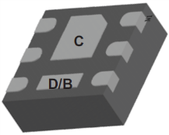
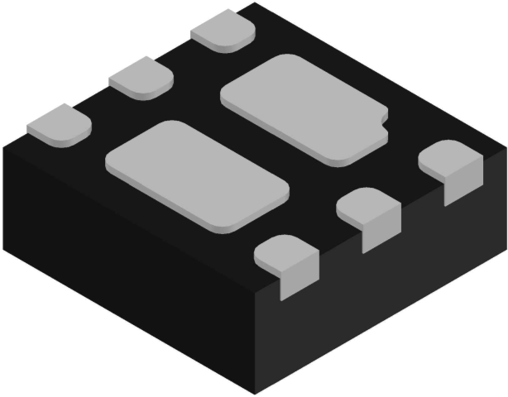
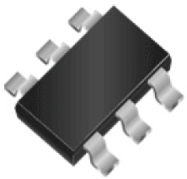
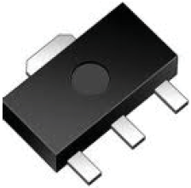
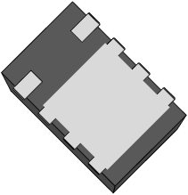
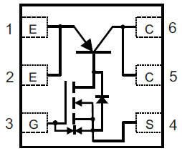
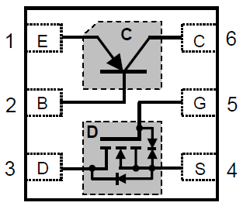
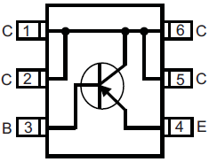
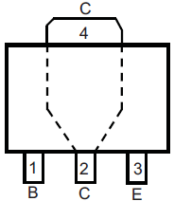
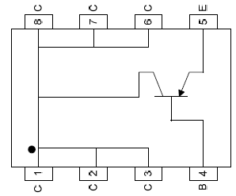
Roadmap of BJT
 | WPT2N31 | WPT2N32 | WPT2F30 | WPT2F42 | WPT2E33 | WPT2N41 | WPT2N43 | WPT2N45
Package
 | DFN2x2-6L | DFN2x2-6L | SOT-23-6L | SOT-23-6L | SOT-89-3L | PDFN3x2-8L | PDFN3x2-8L | PDFN3x2-8L
Pin Configuration
V_{CEO}(V) | -30 | -30 | -30 | -30 | -30 | -32 | -20 | -20
I_{C}(A) For Typical Application | -0.8 | 0.8 | -0.8 | -1 | -1 | -1 | -1.5 | -2
Status | MP | MP | MP | MP | MP | MP | ES | ES

Slide 7
The end

